Slide 1
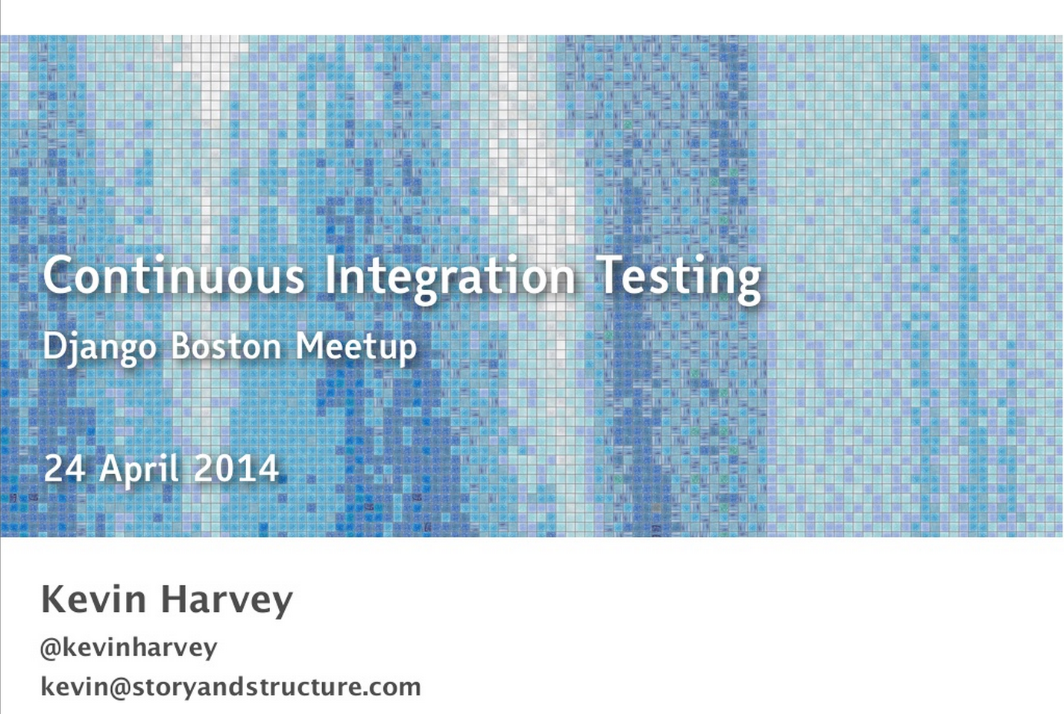
http://www.slideshare.net/kevincreedharvey/continuous-integration-testing-django-ap

Slide 2
What is CI?
“Continuous Integration (CI) is a development practice that requires developers to integrate code into a shared repository several times a day. Each check-in is then verified by an automated build, allowing teams to detect problems early.”
http://www.thoughtworks.com/continuous-integration
http://martinfowler.com/articles/continuousIntegration.html

Slide 3
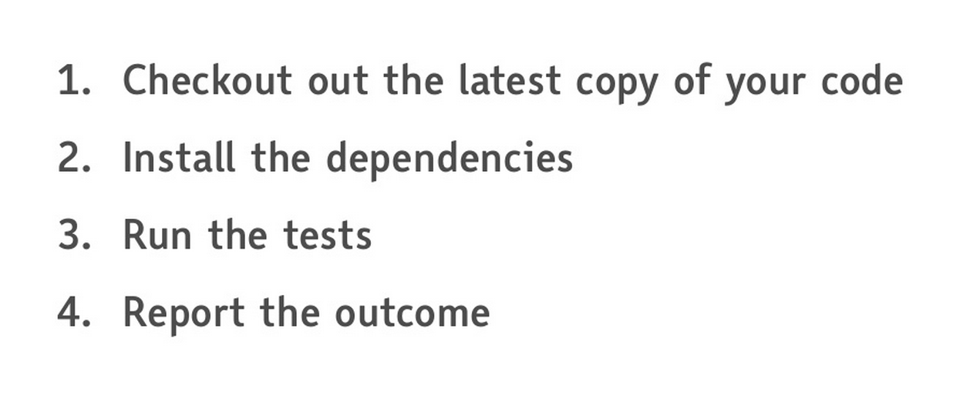
Role of a CI server

Slide 4
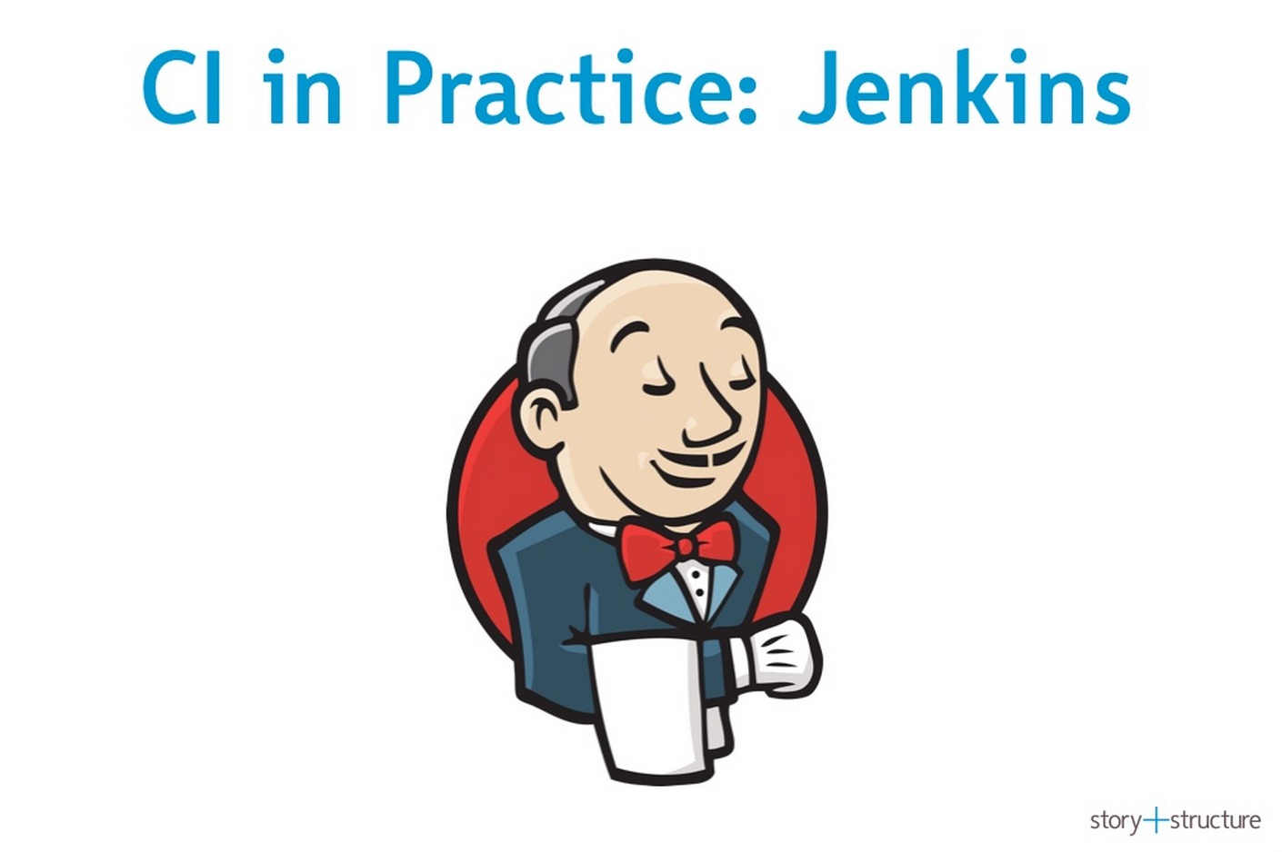


Slide 5
Installing Jenkins
On CentOS/RedHat:
sudo wget -O /etc/yum.repos.d/jenkins.repo http://pkg.jenkins-ci.org/redhat/jenkins.repo
sudo rpm --import http://pkg.jenkins-ci.org/redhat/jenkins-ci.org.key
sudo yum install jenkins
then:
service jenkins start
Point a browser at:
localhost:8080
and you’re off!
jenkins:https://wiki.jenkins-ci.org/display/JENKINS/Installing+Jenkins+on+RedHat+distributions

Slide 6
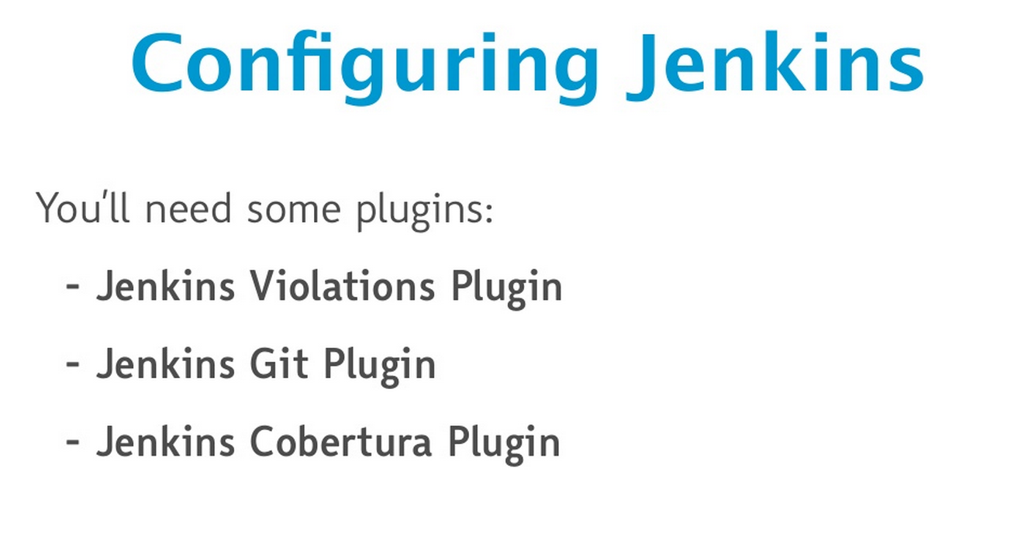
In Jenkins dashboard:
Manage Jenkins > Manage Plugins
In the Available tab, search for and install the above plugins.

Slide 7
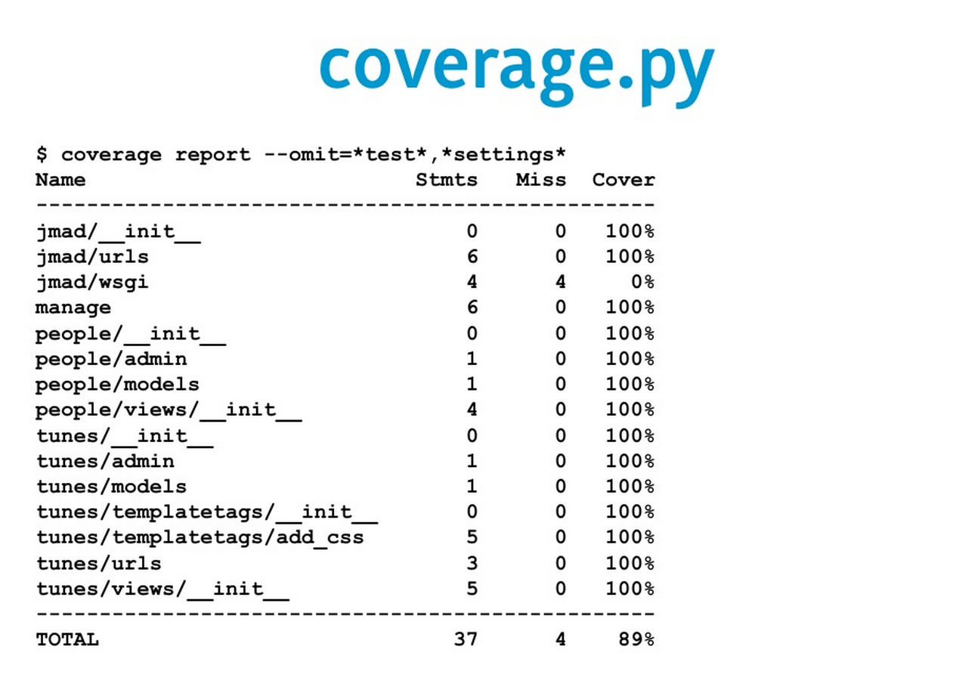
http://nedbatchelder.com/code/coverage/

Slide 8
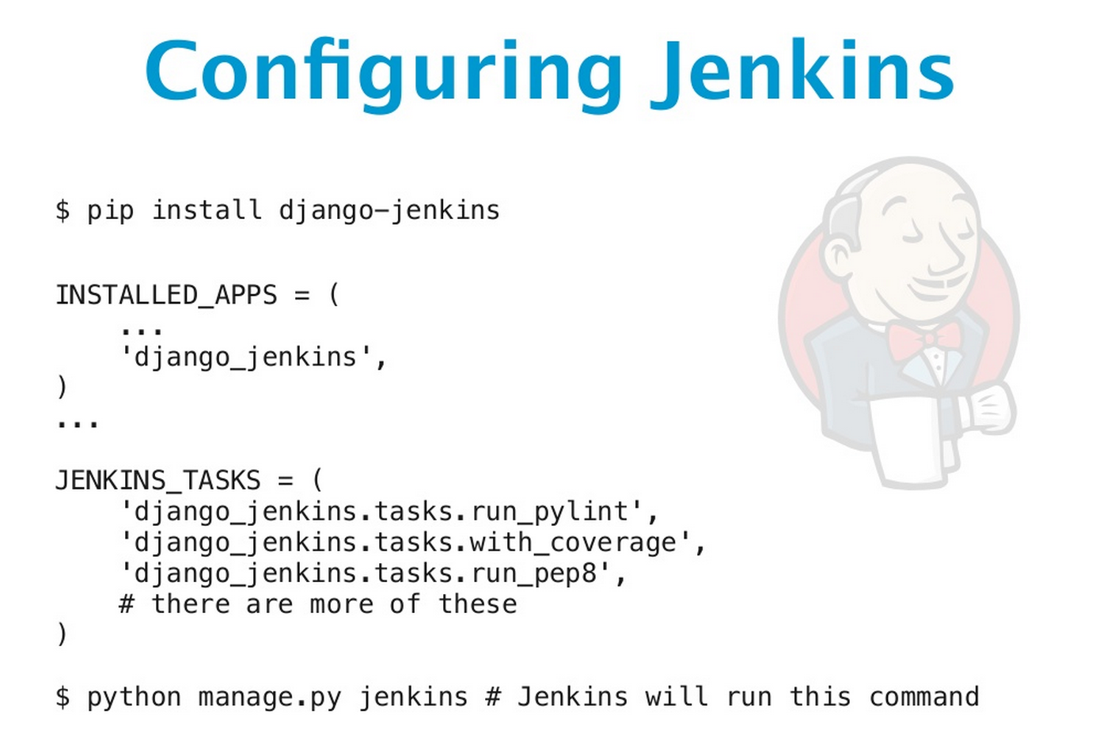
(with Django)
django-jenkins is a plugin that runs the tests and outputs the files that Jenkins needs to report on the build.
https://sites.google.com/site/kmmbvnr/home/django-jenkins-tutorial

Slide 9
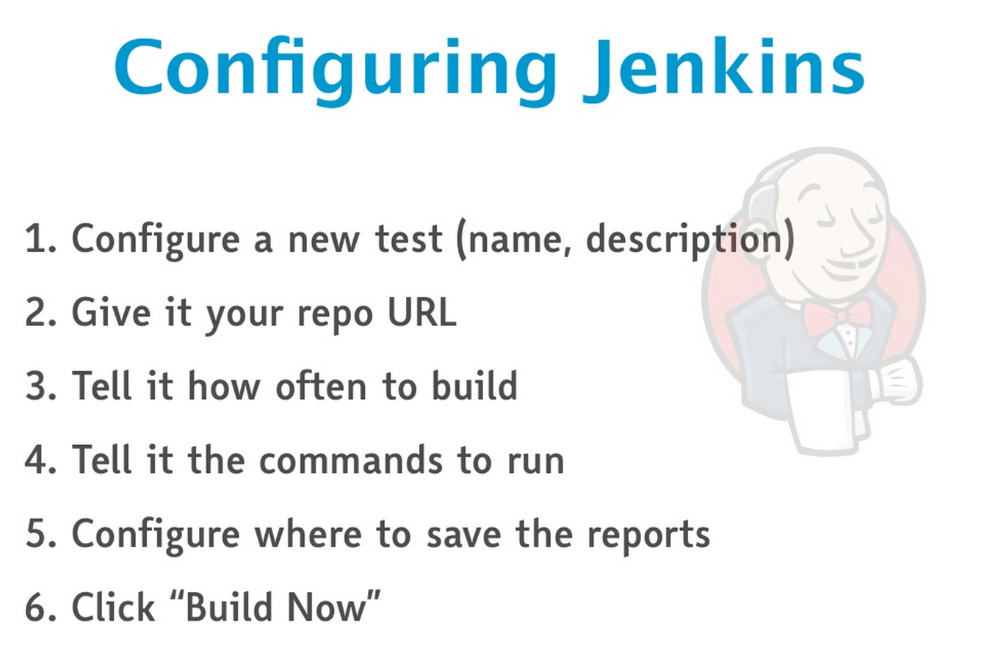

Slide 10
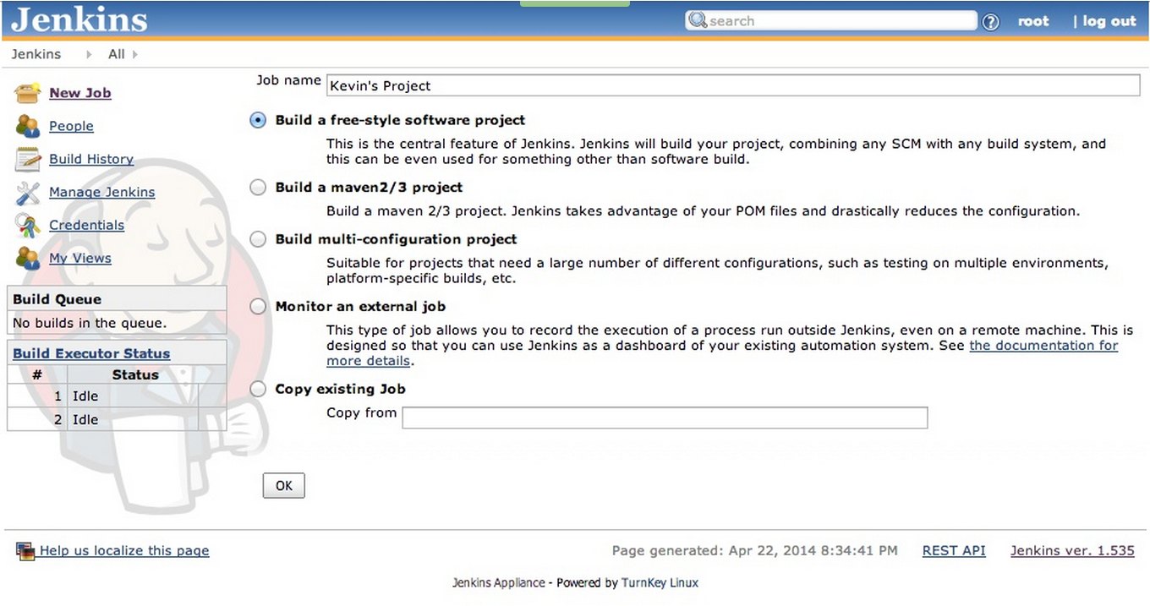
1) Create a new Job

Slide 11
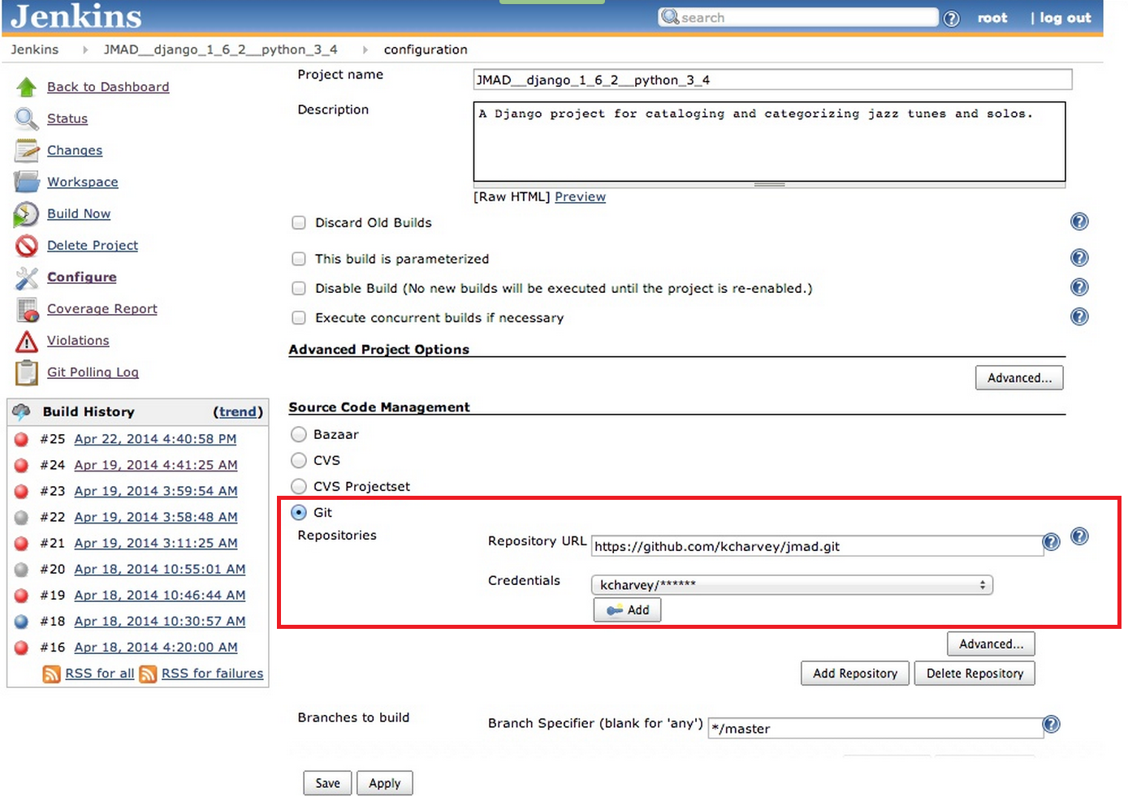
2) Configure your source code repo:

Slide 12
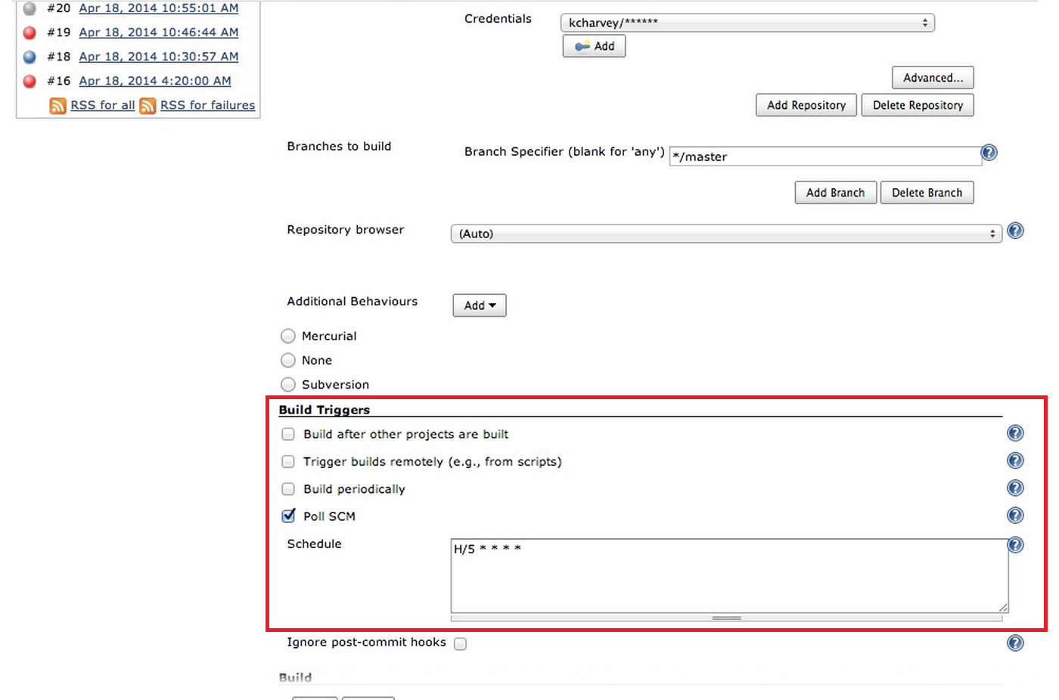
3) Specify triggers for the build (e.g. poll a git repo every 5mins for new commits).

Slide 13
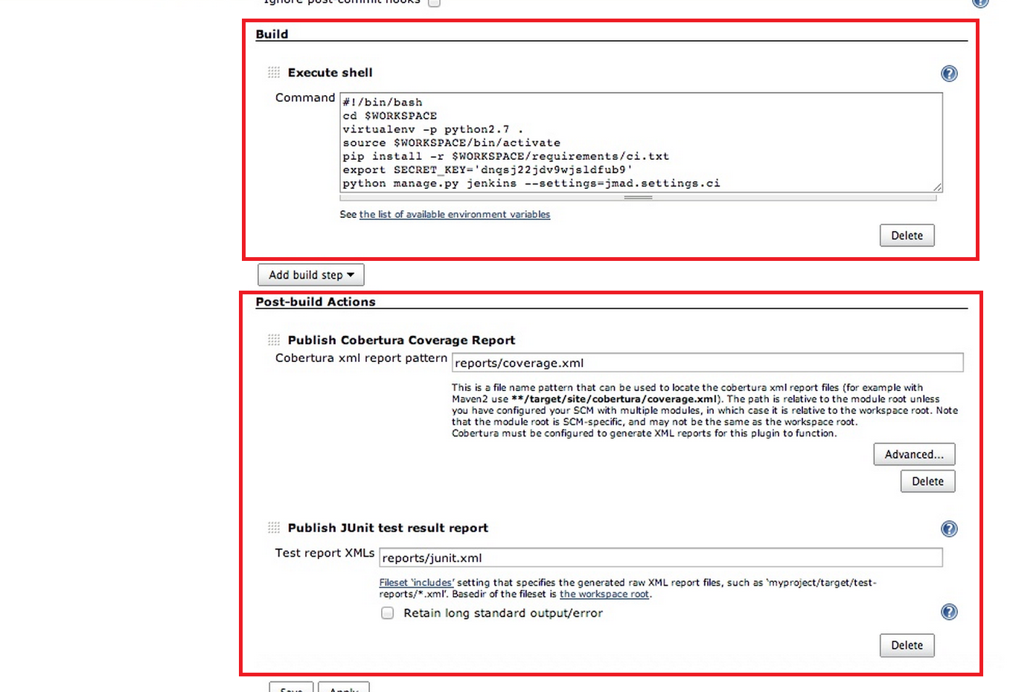
4) Define the build script:
5) Configure report output files locations (e.g. coverage etc)

Slide 14
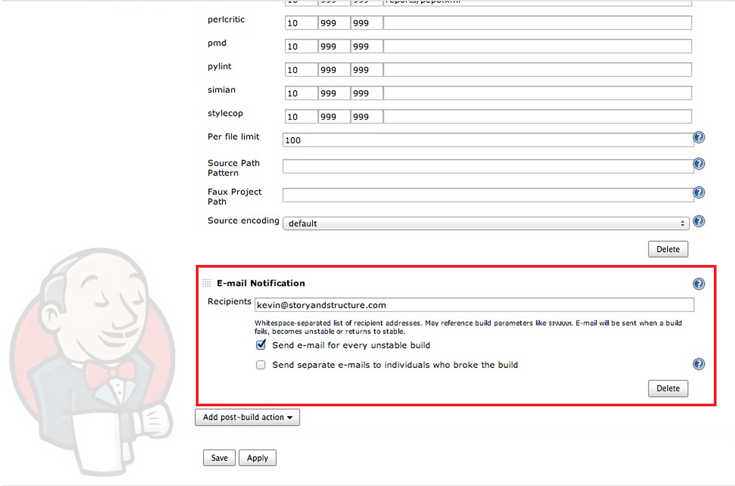
5) Send e-mail notifications for unstable builds.

Slide 15
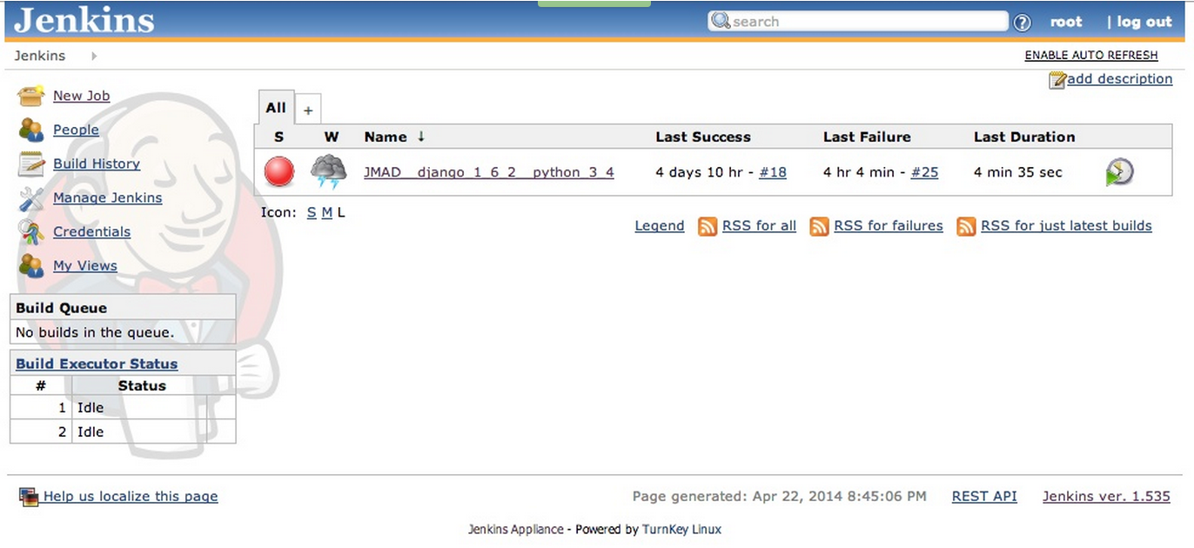
Main dashboard

Slide 16
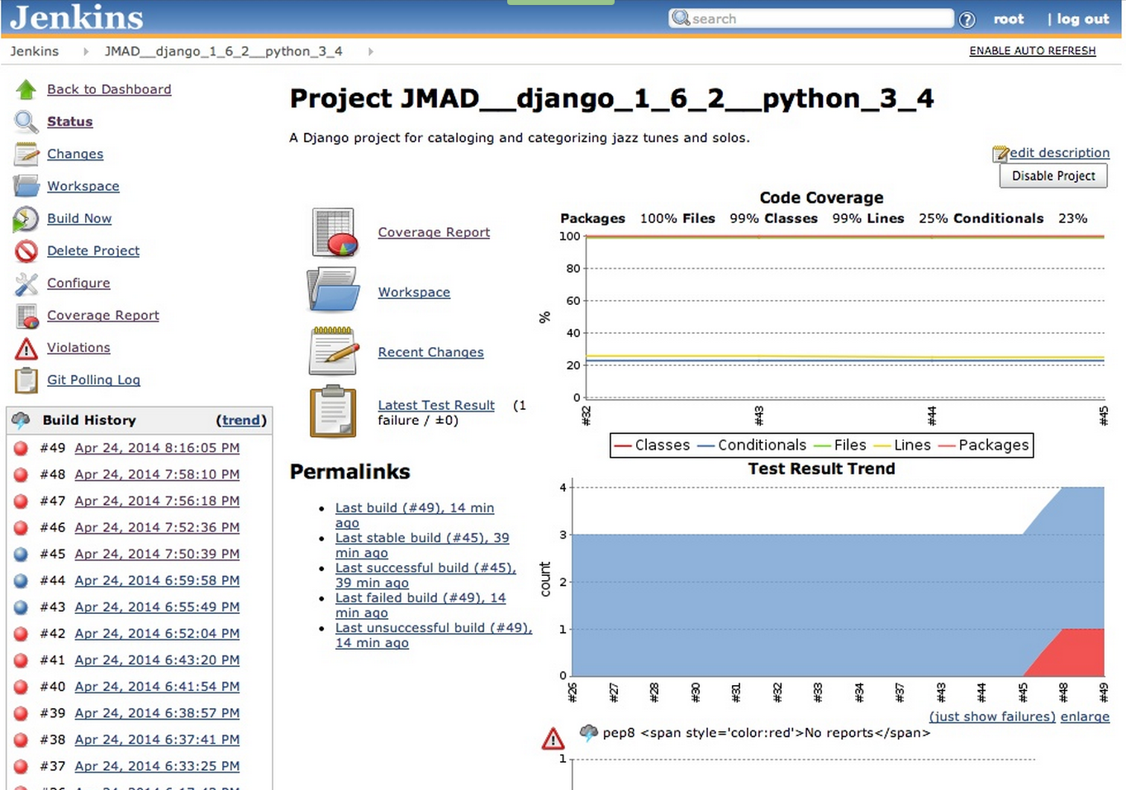
Build details

Slide 17
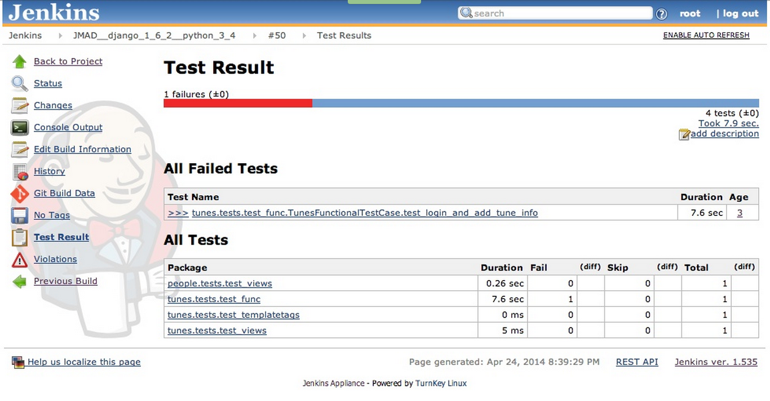
Plenty of info to drill down into:

Slide 18
Selenium tests
To allow selenium webdriver test classes, need to install xvfb on the server.
sudo yum install xorg-x11-server-Xvfb
In jenkins:
Install the xvfb plugin.
Then:"Manage Jenkins" => "Configure System" => "Xvfb installation“
Add xvfb installation, chose automatic config and give it a name (e.g. xvfb-jenkins).
In the Jenkins project configure the option:
Start Xvfb before the build, and shut it down after
Click advanced, then:
check - 'Let Xvfb choose display name' & 'I’m running this job in parallel on same node' & 'Log Xvfb output‘
timeout in secs: 0
Xvfb screen: 1020x768x24
Xvfb display name offset: 1

